Slide 2
Whether an organism is a human being or a mouse, is tall or short, has long hair or short hair, has light skin or dark, is determined by the types of proteins the organism synthesizes.
Moreover, the properties of muscle cells differ from those of nerve cells and epithelial cells because of the types of proteins present in each cell type and the functions performed by these proteins.
The information for synthesizing the cell’s proteins is contained in the hereditary material in each cell coded into DNA molecules.
Given that different cell types synthesize different proteins and that the specifications for these proteins are coded in DNA, one might conclude that different cell types contain different DNA molecules
All cells in the body, except for sperm or egg cells, receive the same genetic information when DNA molecules are duplicated and passed on to daughter cells at the time of cell division

Slide 3
Therefore, cells differ in structure and function because only a portion of the total genetic information common to all cells is used by any given cell to synthesize proteins

Slide 4
Genetic Code
Molecules of DNA contain information, coded in the sequence of nucleotides, for the synthesis of proteins.
A sequence of DNA nucleotides containing the information that specifies the amino acid sequence of a single polypeptide chain is known as a gene.
A gene is thus a unit of hereditary information.
A single molecule of DNA contains many genes
The total genetic information coded in the DNA of a typical cell in an organism is known as its genome.
The human genome contains between 50,000 and 100,000 genes, the information required for producing 50,000 to 100,000 different proteins

Slide 5
Genes are DNA sequences that encode proteins (the gene product)
Gene expression refers to the process whereby the information contained in genes begins to have effects in the cell.
DNA encodes and transmits the genetic information passed down from parents to offspring.
Genetic information is contained within the nucleus of a cell
DNA in the nucleus directs protein synthesis but protein synthesis occurs in ribosomes located in the cytoplasm

Slide 6
It is easy to misunderstand the relationship between genes, DNA molecules, and chromosomes.
In all human cells there are 46 separate DNA molecules in the cell nucleus, each molecule containing many genes.
Each DNA molecule is packaged into a single chromosome composed of DNA and proteins, so there are 46 chromosomes in each cell.
A chromosome contains not only its DNA molecule, but a special class of proteins called histone proteins, or simply histones
The cell’s nucleus is a marvel of packaging; the very long DNA molecules, having lengths a thousand times greater than the diameter of the nucleus, fit into the nucleus by coiling around clusters of histones at frequent intervals to form complexes known as nucleosomes.

Slide 7
There are about 25 million nucleosomes on the chromosomes, resembling beads on a string
Though DNA does not itself participate directly in the assembly of protein molecules, the protein synthesis occurs in the cytoplasm
The transfer of information from DNA to the site of protein synthesis is the function of RNA molecules, whose synthesis is governed by the information coded in DNA.
Genetic information flows from DNA to RNA and then to protein
The process of transferring genetic information from DNA to RNA in the nucleus is known as transcription
The process that uses the coded information in RNA to assemble a protein in the cytoplasm is known as translation.

Slide 8
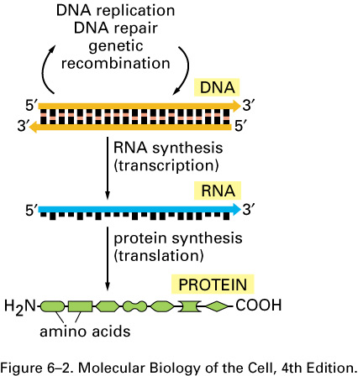
THE CENTRAL DOGMA OF PROTEIN SYNTHESIS

Slide 9
Central Dogma
DNA ---------→ RNA---------→Protein.
This unidirectional flow equation represents the Central Dogma (fundamental law) of molecular biology.
This is the mechanism whereby inherited information is used to create actual objects, namely enzymes and structural proteins.
An exception to the central dogma is that certain viruses (retroviruses) make DNA from RNA using the enzyme reverse transcriptase.

Slide 10
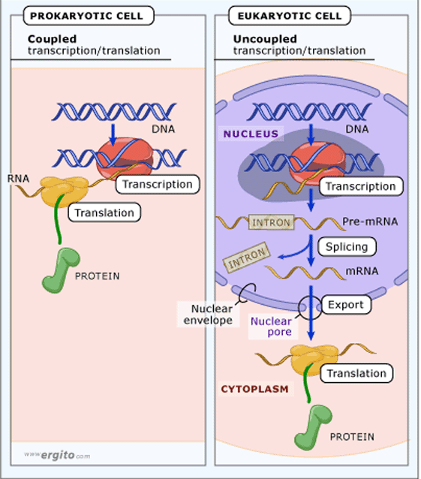

Slide 11
Protein Synthesis: An Overview
How does a ribosome synthesize the protein required if it does not have access to DNA?
The answer lies in an intermediate substance known as mRNA.
Information is copied from DNA into mRNA, this is transcription
mRNA leaves the nucleus and enters the cytoplasm of the cell
Ribosomes use the mRNA as a blueprint to synthesize proteins composed of aa, this is translation.

Slide 12
Nucleic acids:
Principle information molecule in the cell.
All the genetic codes are carried out on the nucleic acids.
Nucleic acid is a linear polymer of nucleotides

Slide 13
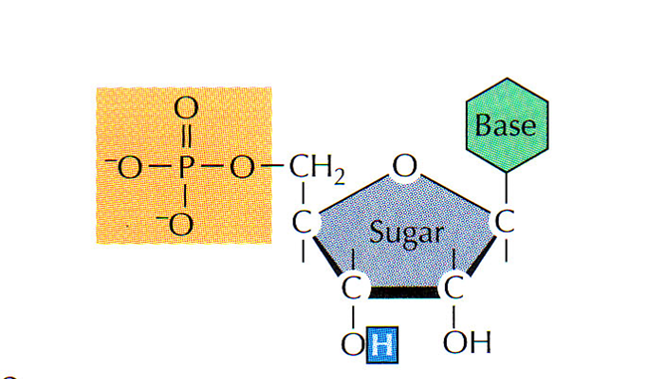
Nucleotides
Nucleotides are the unit structure of nucleic acids.
Nucleotides composed of 3 components:
Nitrogenous base (Adenine, Cytosine, Guanine, Thymine (or Uracil)
Pentose sugar
Phosphate

Slide 14
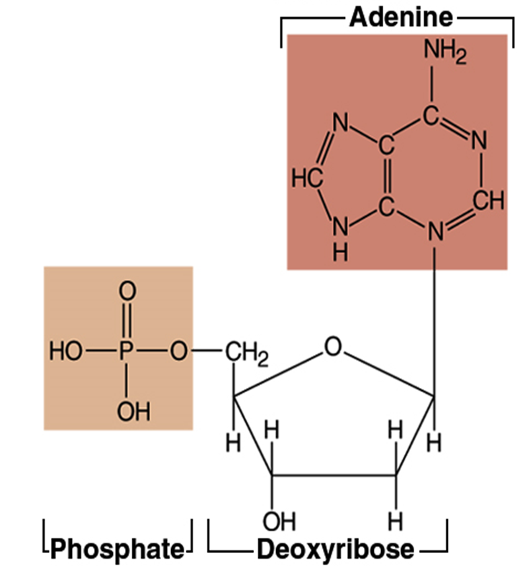

Slide 15
Nitrogenous bases
There are 2 types:
Purines:
Two ring structure
Adenine (A) and Guanine (G)
Pyrimidines:
Single ring structure
Cytosine (C) and Thymine (T) or Uracil (U).

Slide 16
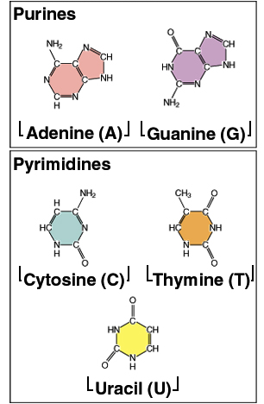
Nitrogenous Bases
Purines - double carbon-nitrogen ring
guanine
adenine
Pyrimidines - single carbon-nitrogen ring
uracil - RNA only
thymine - DNA only
cytosine - both

Slide 17
DNA
A molecule of DNA consists of two chains of nucleotides coiled around each other to form a double helix
3 main components:
Deoxyribose sugar
Phosphate group
Nitrogenous bases-adenine, guanine, cytosine and thymine
Adenine forms 2 hydrogen bonds to Thymine,
Guanine forms 3 hydrogen bonds to Cytosine

Slide 18
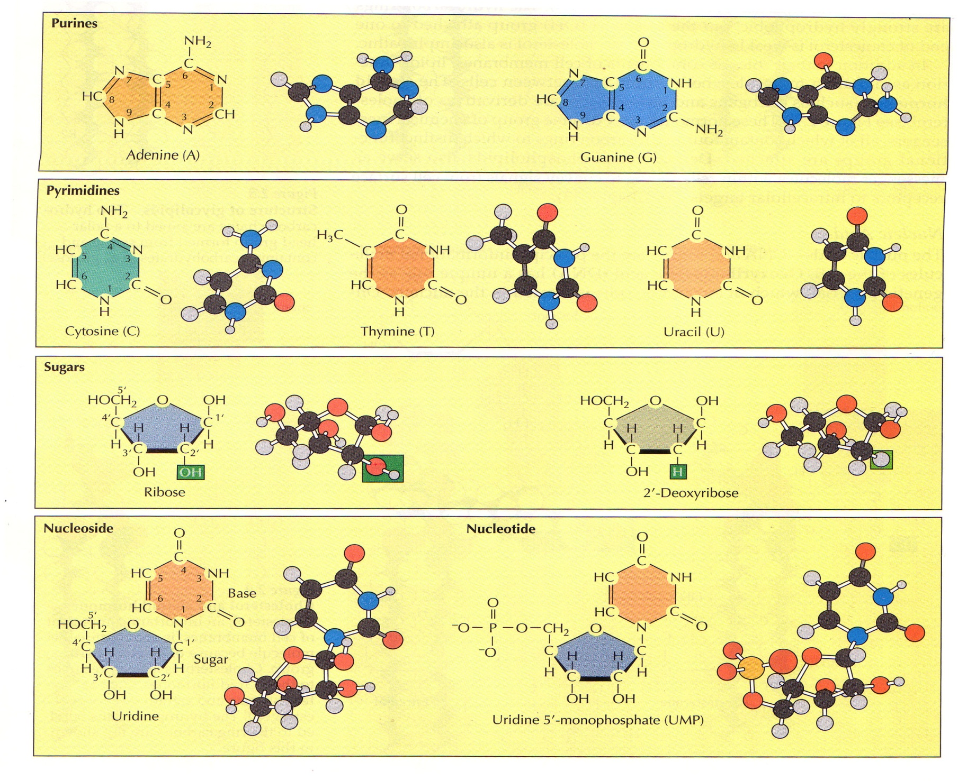
Nucleotide bases

Slide 19
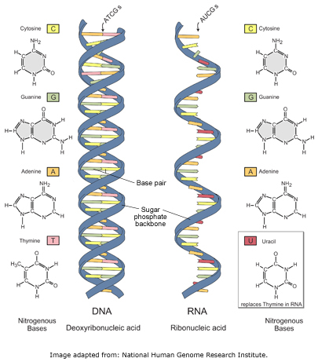

Slide 20
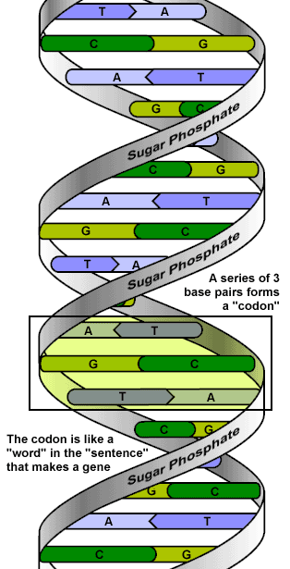

Slide 21
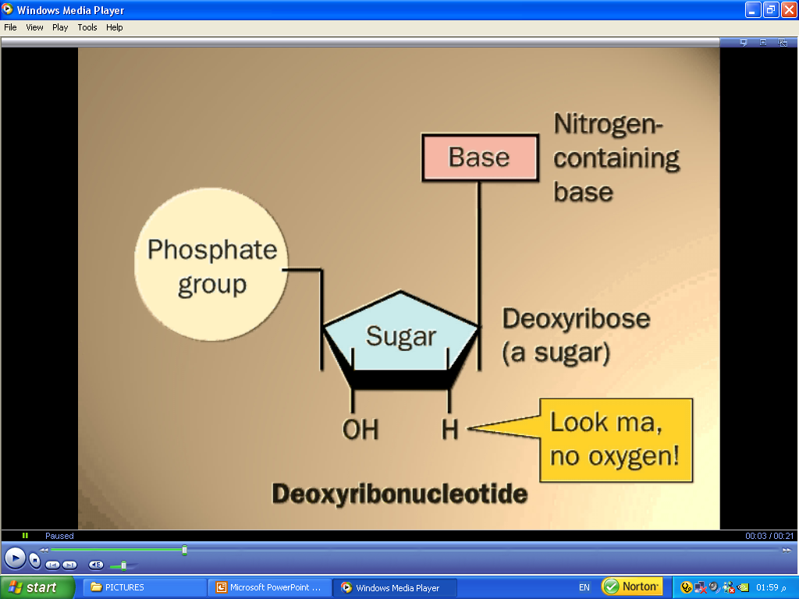
There are 2 types of nucleic acids:
Deoxy-ribonucleic acid (DNA)
Pentose Sugar is deoxyribose (no OH at 2’ position)
Bases are Purines (A, G) and Pyrimidine (C, T).

Slide 22
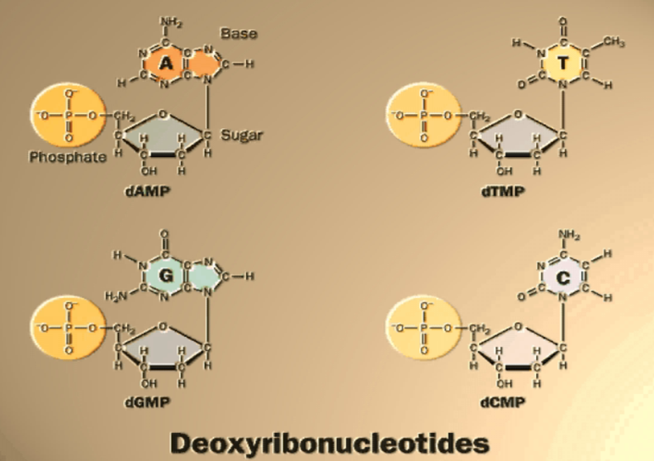

Slide 23
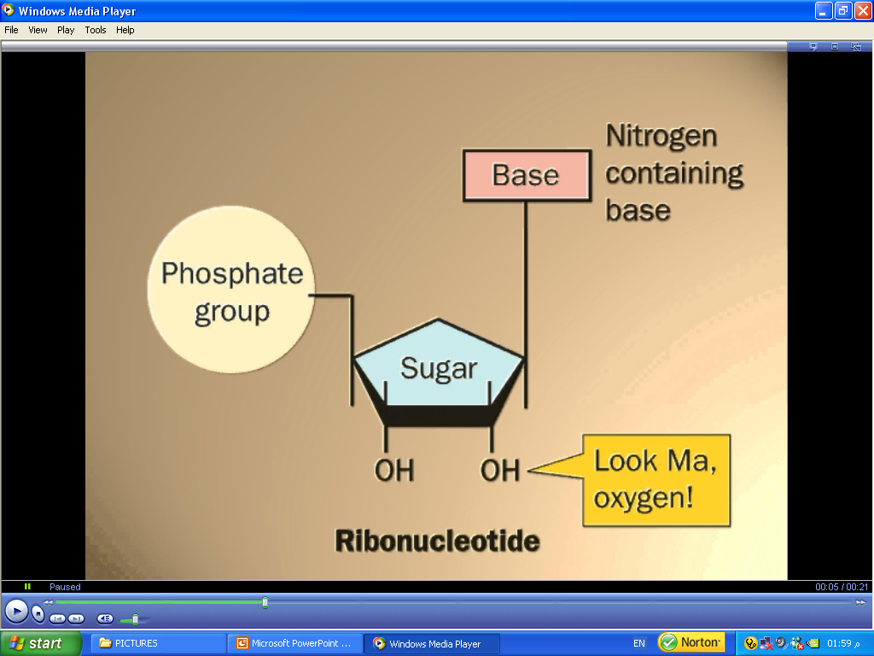
Ribonucleic acid (RNA)
Pentose Sugar is Ribose.
Bases are Purines (A, G) and Pyrimidines (C, U).

Slide 24
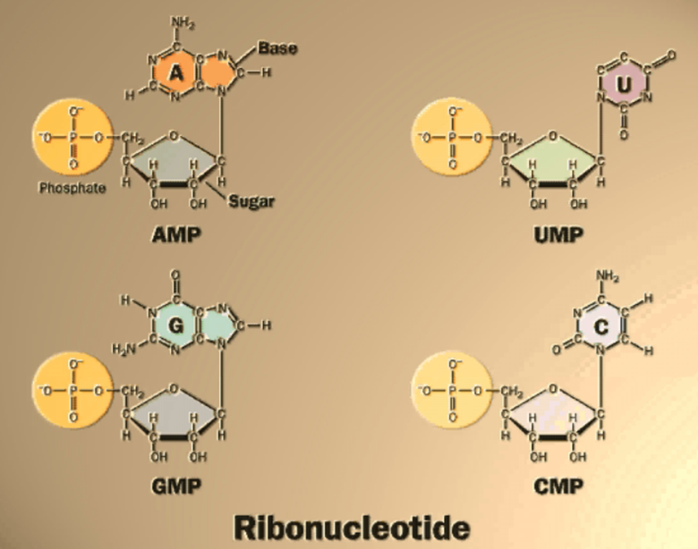

Slide 25
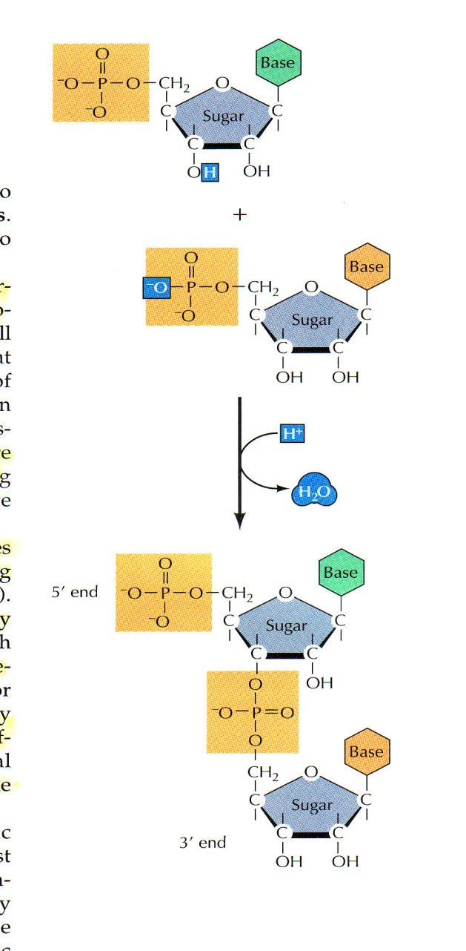
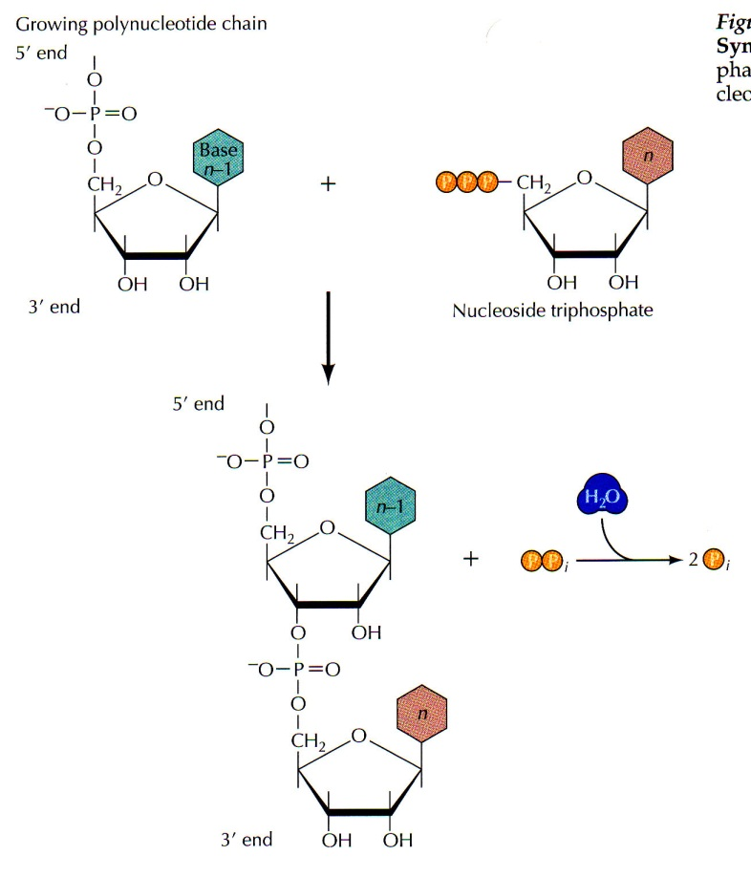
Linear Polymerization of Nucleotides
Nucleic acids are formed of nucleotide polymers.
Nucleotides polymerize together by phospho-diester bonds via condensation reaction.
The phospho-diester bond is formed between:
Hydroxyl (OH) group of the sugar of one nucleotide.
Phosphate group of other nucleotide

Slide 27

Polymerization of Nucleotides
The formed polynucleotide chain is formed of:
Negative (-ve) charged Sugar-Phosphate backbone.
Free 5’ phosphate on one end (5’ end)
Free 3’ hydroxyl on other end (3’ end)
Nitrogenous bases are not in the backbone
Attached to the backbone
Free to pair with nitrogenous bases of other polynucleotide chain

Slide 28
Polymerization of Nucleotides
Nucleic acids are polymers of nucleotides.
The nucleotides formed of purine or pyrimidine bases linked to phosphorylated sugars (nucleotide back bone).
The bases are linked to the pentose sugar to form Nucleoside.
The nucleotides contain one phosphate group linked to the 5’ carbon of the nucleoside.
Nucleotide = Nucleoside + Phosphate group

Slide 29
Complementary base pairing
It is the most important structural feature of nucleic acids
It connects bases of one polynucleotide chain (nucleotide polymer) with complementary bases of other chain
Complementary bases are bonded together via:
Double hydrogen bond between A and T (DNA), A and U (RNA) (A═T or A═U)
Triple H-bond between G and C in both DNA or RNA (G≡C)

Slide 30
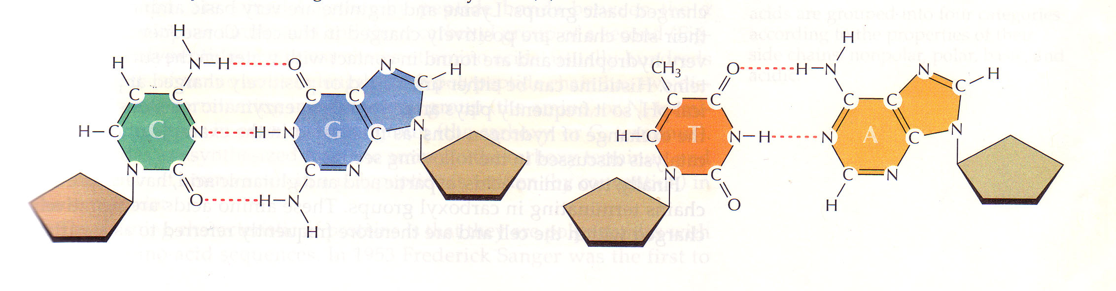
Base pairing

Slide 31
Significance of complementary base pairing
The importance of such complementary base pairing is that each strand of DNA can act as template to direct the synthesis of other strand similar to its complementary one.
Thus nucleic acids are uniquely capable of directing their own self replication.
The information carried by DNA and RNA direct the synthesis of specific proteins which control most cellular activities.

Slide 32
DNA structure
DNA is a double stranded molecule consists of 2 polynucleotide chains running in opposite directions.
Both strands are complementary to each other.
The bases are on the inside of the molecules and the 2 chains are joined together by double H-bond between A and T and triple H-bond between C and G.
The base pairing is very specific which make the 2 strands complementary to each other.
So each strand contain all the required information for synthesis (replication) of a new copy to its complementary.

Slide 33
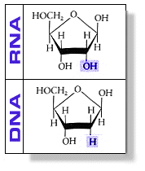
DNA vs RNA
Deoxyribose sugar
Double stranded
A pairs with T
G pairs with C
Resides in nucleus
Ribose sugar
Single stranded
A pairs with U
G pairs with C
Resides in nucleus and cytoplasm

Slide 34
RNA structure
It is formed of linear polynucleotide
It is generally single stranded
The pentose sugar is Ribose
Uracile (U) replace Thymine (T) in the pyrimidine bases.
Although RNA is generally single stranded, intra-molecular H-bond base pairing occur between complementary bases on the same molecule (secondary structure)

Slide 35
Types of RNA
Messenger RNA (mRNA):
Carries genetic information copied from DNA in the form of a series of 3-base code, each of which specifies a particular amino acid.
Transfer RNA (tRNA):
It is the key that read the code on the mRNA.
Each amino acid has its own tRNA, which binds to it and carries it to the growing end of a polypeptide chain.
Ribosomal RNA (rRNA):
Associated with a set of proteins to form the ribosomes.
These complex structures, which physically move along the mRNA molecule, catalyze the assembly of amino acids into protein chain.
They also bind tRNAs that have the specific amino acids according to the code.

Slide 36
RNA structure
RNA is a single stranded polynucleotide molecule.
It can take 3 levels of structure;
Primary: sequence of nucleotides
Secondary: hairpin loops (base pairing)
Tertiary: motifs and 3D foldings

Slide 37
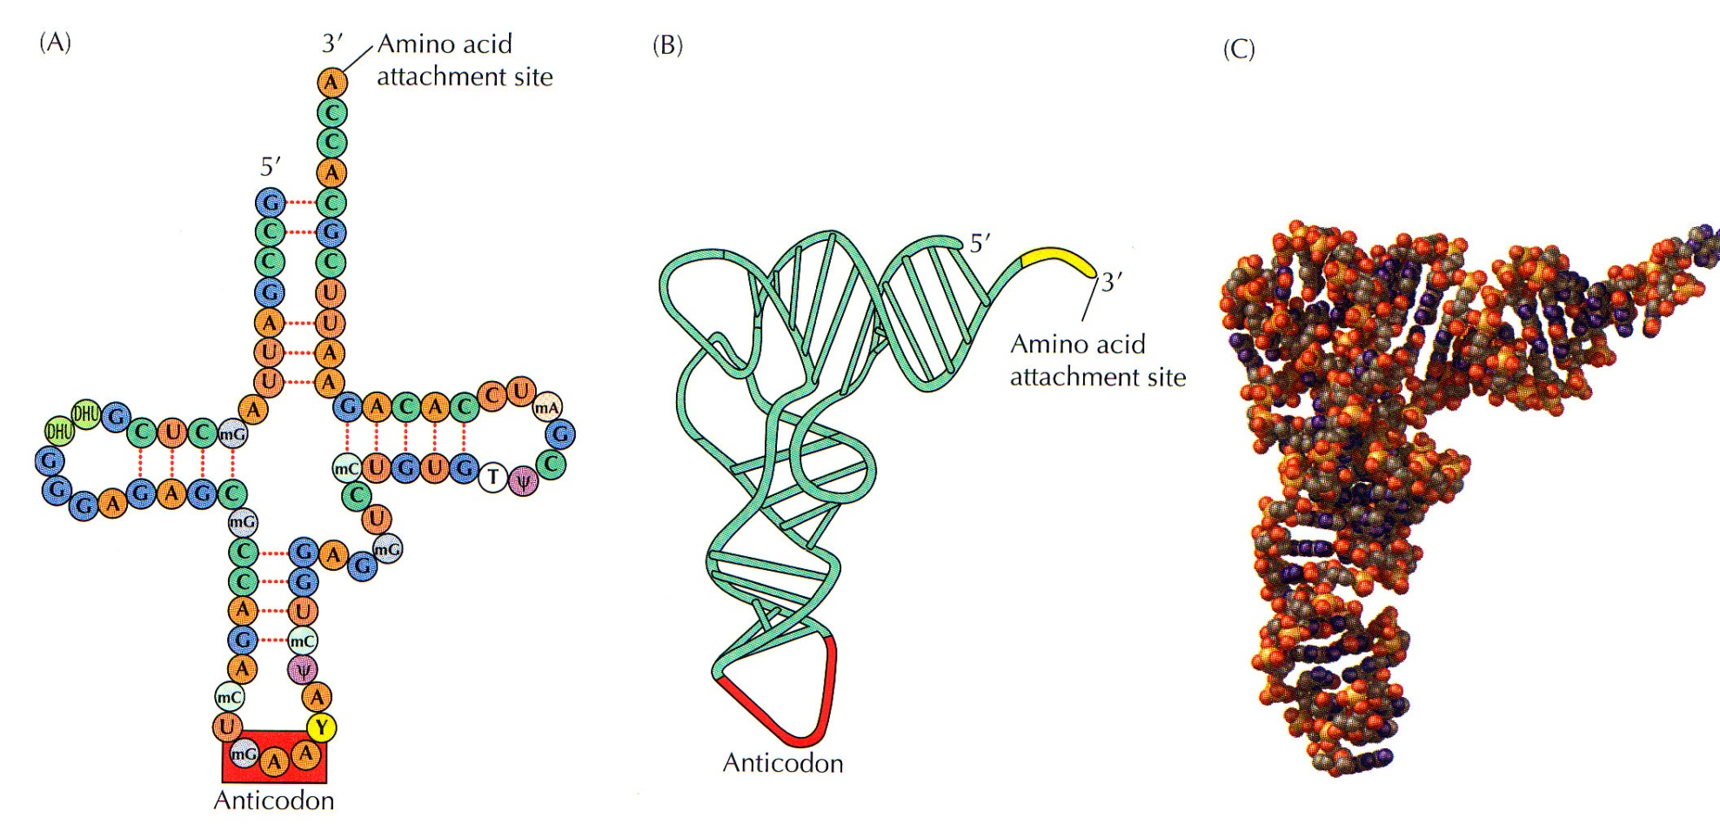
RNA structure
Transfer RNA (tRNA) structure

Slide 38
RNA
There are three types of RNA:
mRNA is the “blueprint” for construction of a protein
rRNA is the “construction site” where the proteins are made
tRNA is the “truck” delivering the proper aa to the site of protein synthesis

Slide 39
Genes and Proteins
Genes are a sequence of nucleotides in DNA that code for a particular protein
Proteins drive cellular processes, determine physical characteristics, and manifest genetic disorders by their absence or presence

Slide 40
Genetic Code
Proteins are composed of 20 different amino acids
A sequence of 3 nucleotides is used to code each amino acid
Each triplet of nucleotides is called a codon
Start codon AUG codes for amino acid methionine
3 stop codons
There are 64 codons in the genetic code 4³=64
Several different codons can code for the same AA, but no codon ever has more than one amino acid counterpart.
Codons are always written in the form of the RNA transcript from the original DNA molecule.

Slide 41
The genetic language is similar in principle to a written language, which consists of a set of symbols, such as A, B, C, D, that form an alphabet.
The letters are arranged in specific sequences to form words, and the words are arranged in linear sequences to form sentences.
The genetic language contains only four letters corresponding to the bases A, G, C, and T.
The genetic words are three-base sequences that specify particular amino acids—that is, each word in the genetic language is only three letters long.
This is termed a triplet code.
The sequence of three-letter code words (triplets) along a gene in a single strand of DNA specifies the sequence of amino acids in a polypeptide chain

Slide 42
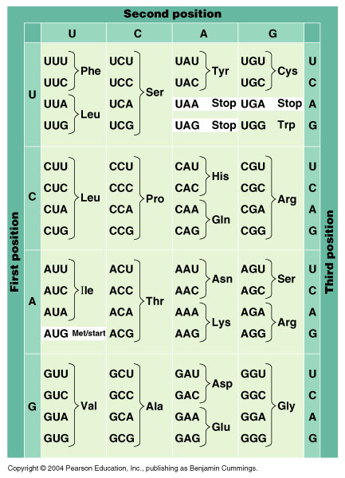

Slide 43
The genetic code is a universal language used by all living cells.
Eg: the code words for the amino acid tryptophan are the same in the DNA of a bacterium, an amoeba, a plant, and a human being.
Although the same code words are used by all living cells, the messages they spell out—the sequences of code words that code for a specific protein—vary from gene to gene in each organism.
The universal nature of the genetic code supports the concept that all forms of life on earth evolved from a common ancestor.

Slide 44
Characteristics of the Code
Continuity The genetic code reads as a long series of three-letter codons that have no spaces or punctuation and never overlap.
Redundancy – Several different codons can code for the same amino acid, but no codon ever has more than one amino acid counterpart.
Universality – the genetic code is the same in almost all living organisms, from bacteria to mammals

Slide 45
Protein synthesis
The 2 chains in DNA helix are linked together by H-bonds between specific pairs of bases—A–T and C–G.
To initiate RNA synthesis, the two strands of the double helix must separate so that the bases in the exposed DNA can pair with the bases in free ribonucleotide triphosphates
The pool of subunits used to synthesize mRNA are free (uncombined) ribonucleotide triphosphates: ATP, GTP, CTP, and UTP
Free ribonucleotides containing U bases pair with the exposed A bases in DNA while free ribonucleotides containing G, C, or A pair with the exposed DNA bases C, G, and T, respectively.
NB: Uracil, is present in RNA but not DNA, pairs with the base adenine in DNA.
In this way, the nucleotide sequence in one strand of DNA acts as a template that determines the sequence of nucleotides in mRNA.

Slide 46
The aligned ribonucleotides are joined together by the enzyme RNA polymerase, which hydrolyses the nucleotide triphosphates, releasing two of the terminal phosphate groups, and joining the remaining phosphate in covalent linkage to the ribose of the adjacent nucleotide.
Since DNA consists of two strands of polynucleotides, both of which are exposed during transcription, it should theoretically be possible to form two different RNA molecules, one from each strand.

Slide 47
However, only one of the two potential RNAs is ever formed
Which of the two DNA strands is used as the template strand for RNA synthesis from a particular gene is determined by a specific sequence of DNA nucleotides called the promoter, which is located near the beginning of the gene on the strand that is to be transcribed
It is to this promoter region that RNA polymerase binds.
RNA polymerase recognizes the promoter region which is a sequence of DNA rich in A and T bases (TATA box) found only on one strand of the DNA.

Slide 48
Thus, for any given gene, only one strand is used, and that is the strand with the promoter region at the beginning of the gene.
However, different transcribed genes may be located on either of the two strands of the DNA double helix
Transcription begins with the binding of RNA polymerase to the promoter region of that gene.
This initiates the separation of the two strands of DNA.
RNA polymerase moves along the template strand, joining one ribonucleotide at a time (at a rate of about 30 nucleotides per second) to the growing RNA chain.

Slide 49
Transcription: Initiation: 25th Oct
Upon reaching a “stop” signal specifying the end of the gene, the RNA polymerase releases the newly formed RNA transcript.
After the RNA transcript is released, a series of 100 to 200 adenine nucleotides is added to its end, forming a poly Atail that acts as a signal to allow RNA to move out of the nucleus and bind to ribosomes in the cytoplasm

Slide 50
In a given cell, the information in only 10 to 20% of the genes present in DNA is transcribed into RNA.
Genes are transcribed only when RNA polymerase can bind to their promoter sites.
Various mechanisms, are used by cells either to block or to make accessible the promoter region of a particular gene to RNA polymerase.
Such regulation of gene transcription provides a means of controlling the synthesis of specific proteins and thereby the activities characteristic of a particular type of differentiated cell

Slide 51
NOTE:
The base sequence in the RNA transcript is not identical to that in the template strand of DNA, since the RNA’s formation depends on the pairing between complementary, not identical, bases
A three-base sequence in RNA that specifies one amino acid is called a codon.
Each codon is complementary to a three-base sequence in DNA. For example, the base sequence T–A–C in the template strand of DNA corresponds to the codon A–U–G in transcribed RNA.

Slide 52
Transcription: Initiation
An RNA polymerase cannot recognize the TATA box and other landmarks of the promoter region on its own.
Another protein, a transcription factor that recognizes the TATA box, binds to the DNA before the RNA polymerase can do so.

Slide 53
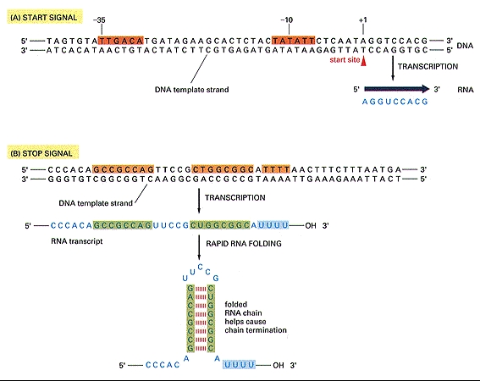
Transcription: Initiation
For transcription to be initiated, both promoter sequences must be present in their correct locations.
The nucleotide sequences in the promoters are slightly different from one another, which means the RNA polymerase will bind in only 1 orientation, thus RNA polymerase can only face 1 way during transcription.
This ensures transcription will proceed in only 1 direction.

Slide 54
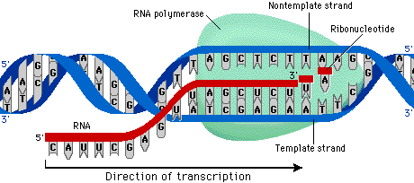
Transcription: Elongation

Slide 55
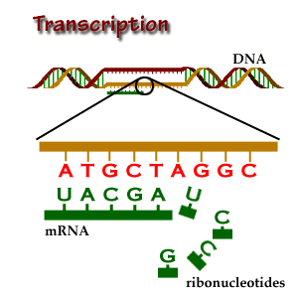

Slide 56
Transcription : Elongation
The RNA polymerase uses only one of the strands of DNA as a template for mRNA synthesis.
This is called the template strand or sense strand.
The coding strand or anti-sense strand contains the complementary nucleotide sequence to the sense strand.
RNA polymerases can add nucleotides only to the 3’ end of a DNA sequence.
Thus, an RNA molecule elongates in the 5’ to 3’ direction.

Slide 57
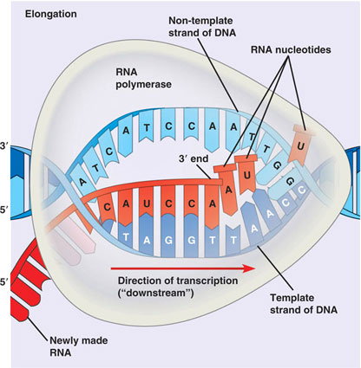
The Coding Strand
RNA polymerase uses the template strand to transcribe.
Thus the RNA is complimentary to the template.
The coding strand is exactly identical to the mRNA, but mRNA has uracil in place of thymine.

Slide 58
Transcription: Termination
As the RNA polymerase molecule passes, the DNA helix re-forms.
Synthesis continues until the end of a gene is reached where RNA polymerase recognizes a terminator sequence.

Slide 59
Transcription
Once the RNA polymerase leaves the promoter region, a new RNA polymerase can bind there to begin a new mRNA transcript.
Since prokaryotes lack a membrane bound nucleus translation can begin even before the mRNA dissociates.
However the pre-mRNA from eukaryotic cells needs some modification before it leave the nucleus.

Slide 60
Processing of mRNA transcript
In eukaryotes, the mRNA that is released at the end of transcription is called pre-mRNA.
Pre-mRNA undergoes several changes before it is exported out of the nucleus to protect it from the cytoplasmic environment.
The 5’ end of the pre-mRNA is capped with a modified form of the G nucleotide.
At the 3’ end, an enzyme in the nucleus adds the poly A tail, a long series of A nucleotides

Slide 61
Although the entire sequence of nucleotides in the template strand of a gene is transcribed into a complementary sequence of nucleotides known as the primary RNA transcript, only certain segments of the gene actually code for sequences of amino acids.
These regions of the gene, known as exons (expression regions), are separated by noncoding sequences of nucleotides known as introns (intervening sequences).
It is estimated that as much as 75–95 percent of human DNA is composed of intron sequences that do not contain protein-coding information.
What role, if any, such large amounts of “nonsense” DNA may perform is unclear.

Slide 62
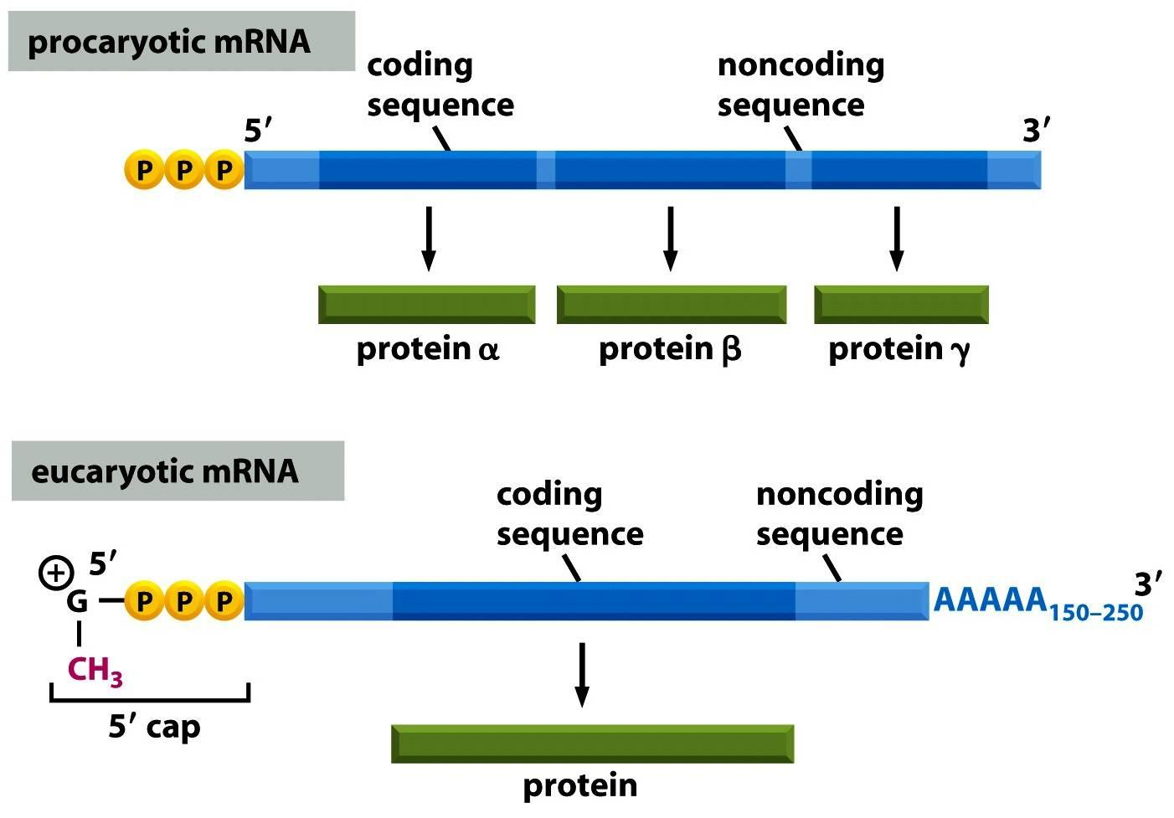
Processing of mRNA

Slide 63
Before passing to the cytoplasm, a newly formed primary RNA transcript must undergo splicing to remove the sequences that correspond to the DNA introns and thereby form the continuous sequence of exons that will be translated into protein
Only after this splicing is the RNA termed messenger RNA
Splicing occurs in the nucleus and is performed by a complex of proteins and small nuclear RNAs known as a spliceosome.

Slide 64
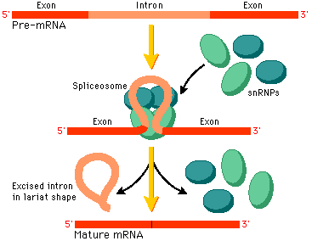
mRNA Splicing
The entire gene (introns and exons) are transcribed by the RNA polymerase.
The initial pre-mRNA contains introns that are removed from the pre-mRNA by spliceosomes while the exons are spliced together.
INtrons are cut OUT.

Slide 65
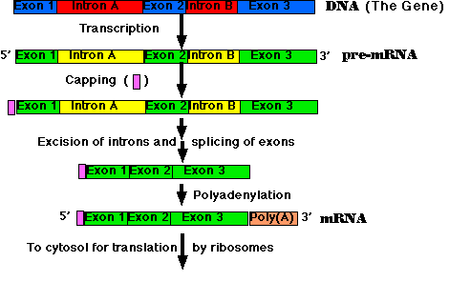
mRNA Splicing
The removal of introns may follow different patterns thus producing different proteins.
This accounts for the fact that the body produces over 100,000 different proteins even thought the human genome only contains 30,000 to 35,000 genes

Slide 66
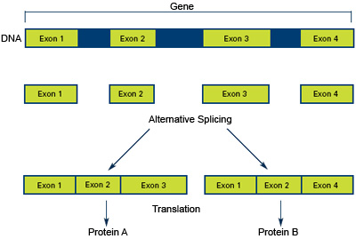
Alternative Splicing

Slide 67
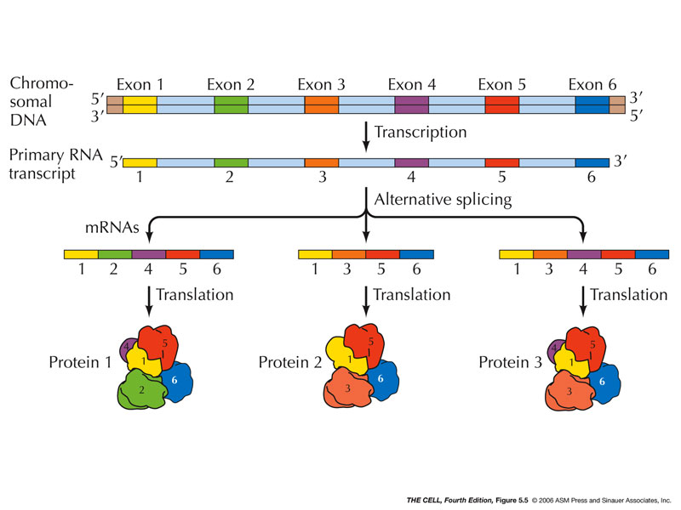
Alternative Splicing

Slide 68
Translation
Ribosomes are small granules in the cytoplasm, either suspended in the cytosol (free ribosomes) or attached to the surface of the endoplasmic reticulum (bound ribosomes).
A typical cell may contain 10 million ribosomes.
A ribosome is a complex particle composed of about 80 different proteins in association with a class of RNA molecules known as ribosomal RNA (rRNA).
The genes for rRNA are transcribed from DNA in a process similar to that for mRNA except that a different RNA polymerase is used.

Slide 69
Ribosomal proteins, are synthesized in the cytoplasm from the mRNAs specific for them.
They then move back through nuclear pores to the nucleolus where they combine with newly synthesized rRNA to form 2 ribosomal subunits, one large and one small.
These subunits then individually transported to cytoplasm where they combine to form a functional ribosome during protein translation.

Slide 70
Translation
After transcription mRNA exits the nucleus via nuclear pores and ribosomes bind to mRNA
Ribosomes synthesize different proteins by reading the coding sequence on mRNA
The mRNA is read in triplets of nucleotides each of which encodes an aa
Consider the following mRNA sequence:
5’ AUGAAUGAGCUGAAC 3’

Slide 71
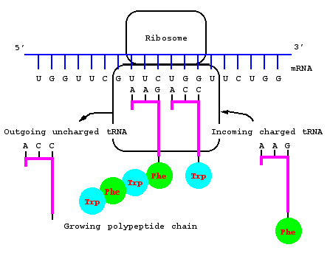

Slide 72
Transfer RNA
The ribosome alone cannot synthesize the polypeptide chain
The correct amino acids must be delivered to the polypeptide building site by tRNA
Transfer RNA molecules are the of the major classes of RNA.
The single chain of tRNA loops back upon itself, forming a structure resembling a cloverleaf with three loops
Synthesized in the nucleus at specific tRNA genes and then move to the cytoplasm.
It has the ability to combine with both a specific amino acid and a codon in ribosome-bound mRNA specific for that amino acid.
This permits tRNA to act as the link between an amino acid and the mRNA codon for that amino acid.

Slide 73
Transfer RNA
tRNA look like three-lobed “cloverleaf” due to base pairing between complementary nucleotides on different regions of each tRNA molecule causing it to fold
A tRNA molecule is covalently linked to a specific amino acid by an enzyme known as aminoacyl-tRNA synthetase
There are 20 different aminoacyl-tRNA synthetases, each of which catalyzes the linkage of a specific amino acid to a specific type of tRNA.

Slide 74
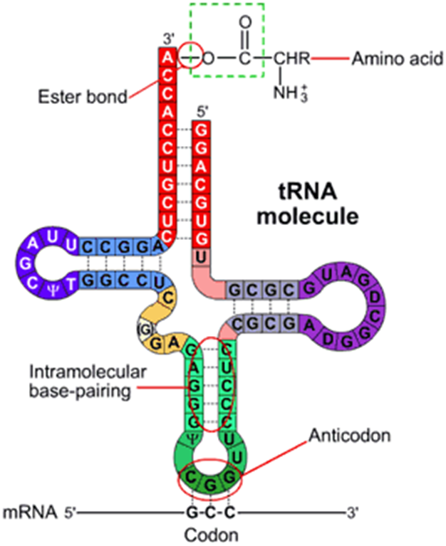

Slide 75
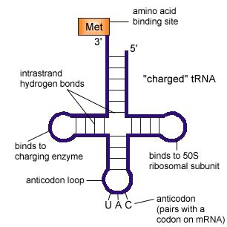
Transfer RNA
At the end of one lobe of tRNA, a sequence of three bases called the anticodon recognizes and is complementary to the codon of the mRNA.
The anticodon sequence is written in the 3’ to 5’ direction.
At the 3’ end of the strand is an attachment site for the corresponding aa specified by the mRNA codon.

Slide 76
Wobble in the Genetic Code
Although there are 64 possible codon combinations, the cytoplasm only holds about 35-45 different tRNAs. This leaves some anti-codons pairing with more than one codon creating a more lenient compliment in the third position.
This is consistent with the redundancy of amino acid codons in the “wobble position hypothesis”

Slide 77
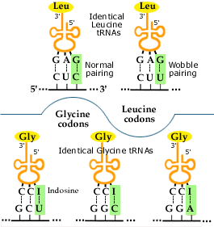

Slide 78
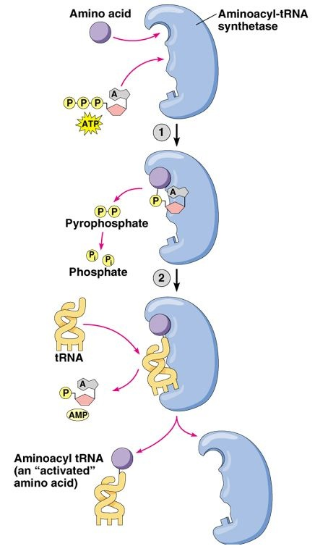
Aminoacyl-tRNA synthetase
Aa-tRNA (tRNA molecule bound to its particular amino acid) has 2 binding sites; one is for a specific amino acid, the other is specific to a particular anticodon
When both are in the enzyme’s active site the enzyme catalyzes a reaction that binds the two.

Slide 79
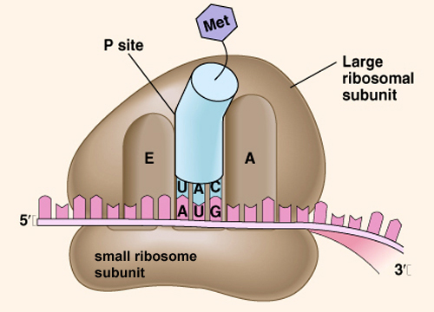
Ribosomes
Ribosomes are the site of protein synthesis.
A ribosome is a complex that contains a cluster of different kinds of proteins and rRNA which are linear strands of RNA
The ribosome has binding sites for the mRNA transcript and the aa-tRNA molecules.

Slide 80
Ribosomes
Each active ribosome has 3 different binding sites for tRNA molecules: the P (peptide) site, which holds one aa-tRNA and the growing chain of amino acids;
the A (acceptor) site, which holds the tRNA bringing the next amino acid to be added to the chain; and
the E (exit) site, which releases the tRNA molecules back into the cytoplasm.

Slide 81
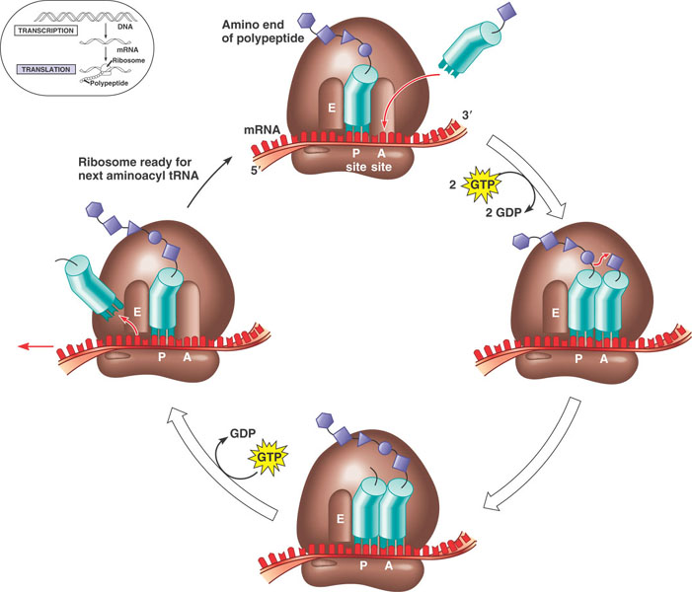
The anticodon of an aa-tRNA molecule binds to the mRNA codon exposed in the A site.
Enzymes catalyze the formation of a bond between the last aa on the lengthening polypeptide and the new aa. The polypeptide chain is transferred from the tRNA in the P site to the tRNA in the A site.
The ribosome moves down the mRNA strand, shifting the binding site a distance of 3 nucleotides (1 codon), this is called translocation. A new A site is exposed as the tRNA that was in the P site is moved to the E site and released.

Slide 82
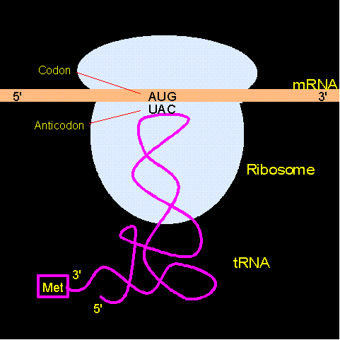

Slide 84
Termination of Protein Synthesis
Translocation of the ribosome exposes a stop codon in the A site. Stop codons do not code for an aa, there are no corresponding tRNAs.
A protein called a release factor binds to the exposed A site causing the polypeptide to separate from the remaining tRNA molecule
Ribosome falls of the mRNA and translation stops

Slide 85
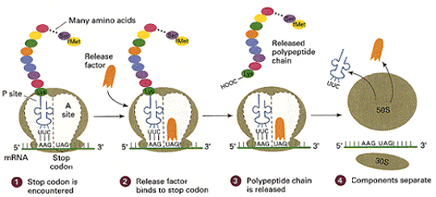
Termination of Protein Synthesis

Slide 86
Synthesis of other substances in the cell
Many protein enzymes formed as described control essentially all the other chemical reactions that take place in cells
They promote synthesis of lipids, glycogen, purines, pyrimidines, and hundreds of other substances.
It is by means of all these substances that the many functions of the cells are performed

Slide 87
Control of gene function and biochemical activity in cells
Genes control both the physical and the chemical functions of the cells
Each cell has powerful internal feedback control mechanisms that keep the various functional operations of the cell in step with one another
For each gene there is at least one such feedback mechanism

Slide 88
There are 2 methods by which the biochemical activities in the cell are controlled.
1. Genetic regulation, in which the degree of activation genes themselves is controlled
2. Enzyme regulation, in which activity levels of already formed enzymes in the cell are controlled

Slide 89
Genetic Regulation
Synthesis of a cellular biochemical product requires a series of rxns, and each of these rxns is catalyzed by a special enzyme.
Formation of enzymes needed for these synthetic process is controlled by a sequence of genes located one after the other on the same chromosomal DNA strand.

Slide 90
This area of the DNA strand is called an operon, and the genes responsible for forming the respective enzymes are called structural genes.
Promoter: a group of nucleotides that has specific affinity for RNA polymerase

Slide 91
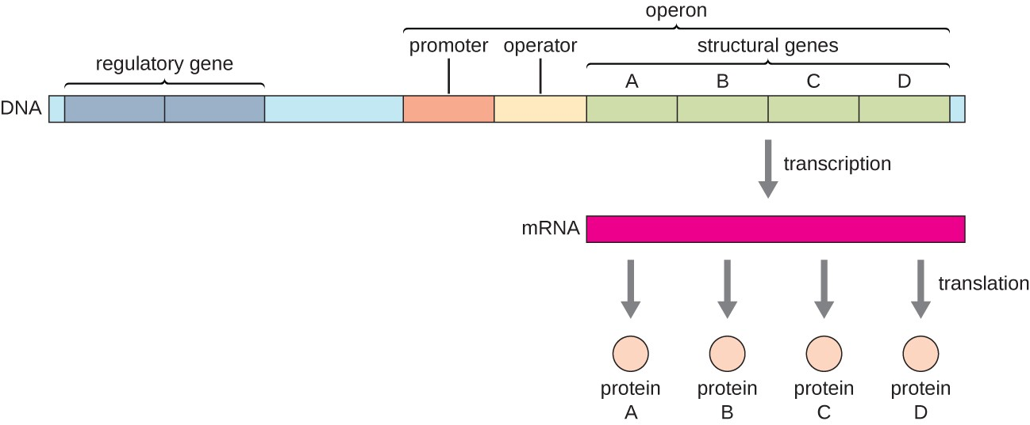

Slide 92
The “Operon” of the cell and its control of biochemical synthesis— function of the promoter
Polymerase must bind with this promoter before it can begin traveling along the DNA strand to synthesize RNA
The promoter is an essential element for activating the operon

Slide 93
Control of the operon by a “Repressor Protein”—The “Repressor Operator
A band of nucleotides lie the middle of the promoter
Called a repressor operator because a “regulatory” protein can bind here and prevent attachment of RNA polymerase to the promoter, thereby blocking transcription of the genes of the operon
Such a negative regulatory protein is called a repressor protein

Slide 94
Control of the operon by an “Activator Protein”—The “Activator Operator
The activator operator, that lies adjacent to but ahead of the promoter
When a regulatory protein binds to this operator, it helps attract RNA polymerase to the promoter, thus activating the operon.
A regulatory protein of this type is called an activator protein

Slide 95
-ve Feedback Control of the Operon
The presence of a critical amount of synthesized product in the cell can cause –ve feedback inhibition of the operon that is responsible for its synthesis
Can do this either by causing a regulatory repressor protein to bind at the repressor operator or by causing a regulatory activator protein to break its bond with the activator operator.
In either case, the operon becomes inhibited

Slide 96
Therefore, once synthesized product has become enough for proper cell function, the operon becomes dormant.
Again, when the synthesized product becomes degraded in the cell and its concentration decreases, the operon once again becomes active.
In this way, the desired concentration of the product is controlled automatically

Slide 97
Other mechanisms for control of transcription by the operon
An operon being controlled by a regulatory gene located elsewhere in the genetic complex of the nucleus.
The regulatory gene causes the formation of a regulatory protein that in turn acts either as an activator or as a repressor substance to control the operon.

Slide 98
Many different operons may be controlled at the same time by the same regulatory protein.
The same regulatory protein functions as an activator for one operon and as a repressor for another.
When multiple operons are controlled simultaneously in this manner, all the operons that function together are called a regulon

Slide 99
Some operons are controlled not at the starting point of transcription on the DNA strand but farther along the strand.
Sometimes the control is not even at the DNA strand itself but during the processing of the RNA in nucleus before release into cytoplasm
In rare cases, the control is at the level of protein formation in the cytoplasm during RNA translation by the ribosomes

Slide 100
DNA is packaged as chromosomes.
Within each chromosome, the DNA is wound around small proteins called histones, which in turn are held tightly together in a compacted state by still other proteins.
As long as DNA is in this compacted state, it cannot function to form RNA.

Slide 101
However, multiple control mechanisms are beginning to be discovered that can cause selected areas of chromosomes to become decompacted one part at a time so that partial RNA transcription can occur
Even then, some specific “transcriptor factor” controls the actual rate of transcription by the separate operon in the chromosome.

Slide 102
Thus, still higher orders of control are used for establishing proper cell function.
In addition, signals from outside the cell, such as some of the body’s hormones, can activate specific chromosomal areas and specific transcription factors, thus controlling the chemical machinery for function of the cell

Slide 103
Because there are more than 30,000 different genes in each human cell, the large number of ways in which genetic activity can be controlled is not surprising.
The gene control systems are especially important for controlling intracellular concentrations of amino acids intermediate substrates and products of carbohydrate, lipid, and protein metabolism

